Slide 1
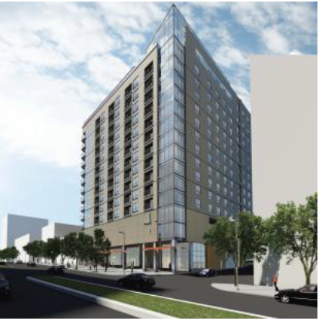
8621 Georgia Avenue Silver Spring, MD
By: Nick Dastalfo
Structural Option
Advisor: Dr. Boothby

Slide 2
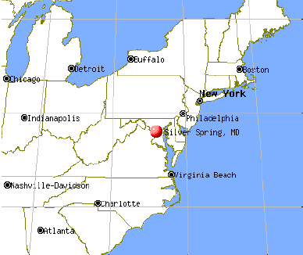
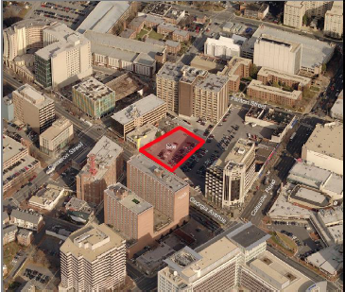
Site Conditions
Location
Existing Site

Slide 3
General Building Information
Owner: Foulger-Pratt Development, LLC
Number of Stories: 17 stories, 161 ft.
Size: 347,009 ft.²
Cost: $51 Million
Structural Engineer: Holbert Apple Associates
Construction: Beginning in 2015
Unique Features: Green Roof, Rooftop Pool

Slide 4
Existing Structural System
Gravity System:
Columns vary in concrete strength
Mild-reinforced two way slab with drop panels
Post-tensioned two way flat slab
7.25” depth, banded and distributed tendons
Lateral System:
Concrete shear walls
Concrete Moment frames
Foundation:
Spread Footings

Slide 5
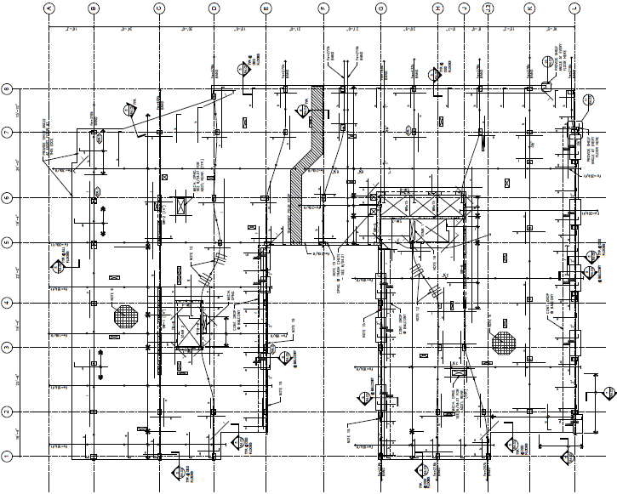
Typical Bay

Slide 6
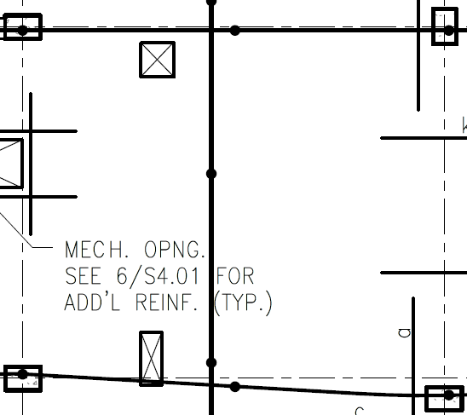
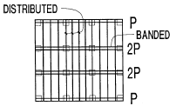
Typical Bay
7.25” post-tensioned slab
Columns: 16” x 24”
Banded and distributed tendons
24’-0”
20’-0”

Slide 7
Gravity Spot Checks -Punching Shear
Punching Shear - Int. Column C6
ΦVc117.65k > Vu=93.1k
Punching Shear – Ext. Column C1
ΦVc103.04k > Vu=55.2k

Slide 8
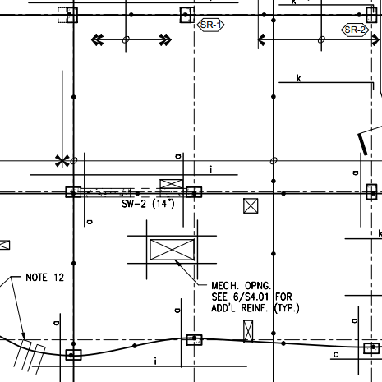
Gravity Spot Checks -One Way Shear
22’-0” Direction
H=7.25”
ΦVc = 152.3k > Vu = 78.5k
20’-2” Direction
H=7.25”
ΦVc = 139.5k > Vu = 79.8k
20’-2”
C6
22’-0”

Slide 9
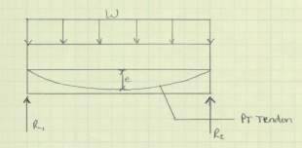
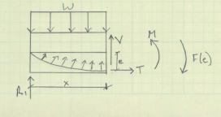
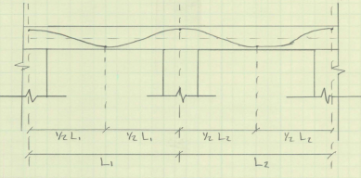
Gravity Spot Checks -Moment Capacity
Deflection Control
0.317” < 0.8”
Load balancing

Slide 10
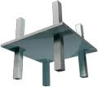
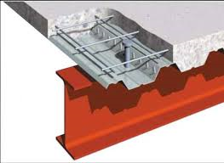
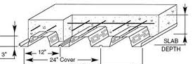
Design Alternates
Alternate #1: Two Way Flat Plate Slab
Alternate #2: Composite Steel
Alternate #3: Non-Composite Steel

Slide 11
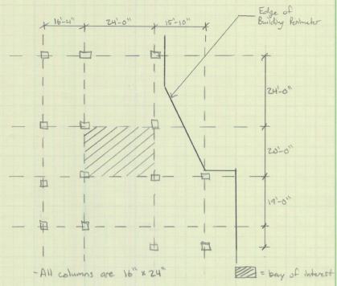
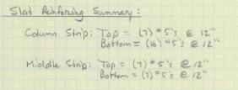
Two Way Flat Plate Slab
Notes:
Thickness = 9”
Rebar fy=60ksi, Concrete f’c= 5ksi
No drop panels

Slide 12
Two Way Flat Plate Slab
Depth
Slight increase from 7.25” to 9”
Fire
Meets at least 2 hr requirement
No additional fire-proofing
Weight = 115 psf
Cost
$19.84/SF
$0.32 savings per SF
Lateral Options
Concrete SW and MF
Conclusion
Heaviest
Limited depth
Viable Option

Slide 13
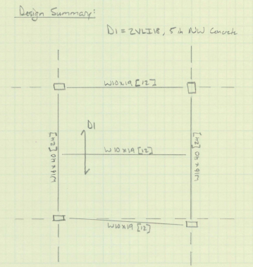
Composite Steel
Notes:
Deck= 2VLI18, 5in. NW Concrete topping
Shoring Required
24’-0”
20’-0”

Slide 14
Composite Steel
Depth
Increase from 7.25” to 21”
Fire
Meets 2 hr requirement with 3.5” topping
Fire-proofing needed on beams and deck
Weight = 75 psf
Cost
$18.48/SF
Cheapest
Lateral Options
Concrete SW or Steel MF
Conclusion
Very Deep
Shoring
Viable but not efficient

Slide 15
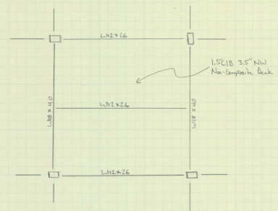
Non-Composite Steel
Notes:
Deck= 1.5C18 3.5” NW Concrete Topping
24’-0”
20’-0”

Slide 16
Non-Composite Steel
Depth
Increase from 7.25” to 21.5”
Fire
Meets 2 hr requirement with 5” topping
Fire-proofing needed on beams and deck
Weight = 60 psf
Cost
$27.60/SF
Most expensive
Lateral Options
Concrete SW and MF
Conclusion
Lightest
Very Deep
Viable Option

Slide 17
Final Comparison

Slide 18
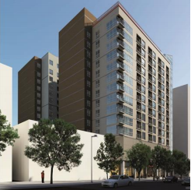
Thank You!
Questions?

